Slide 1
SYSTEM & SOFTWARE VULNERABILITIES
CHAPTER 1:
INTRODUCTION TO HACKING

Slide 2
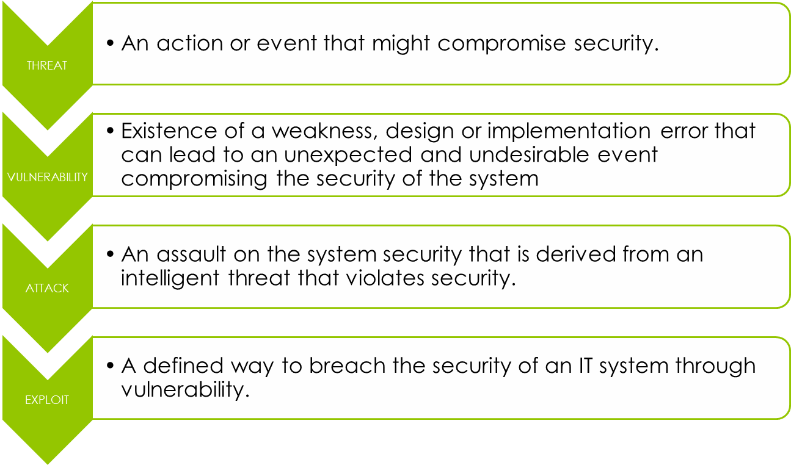
TERMINOLOGIES

Slide 3
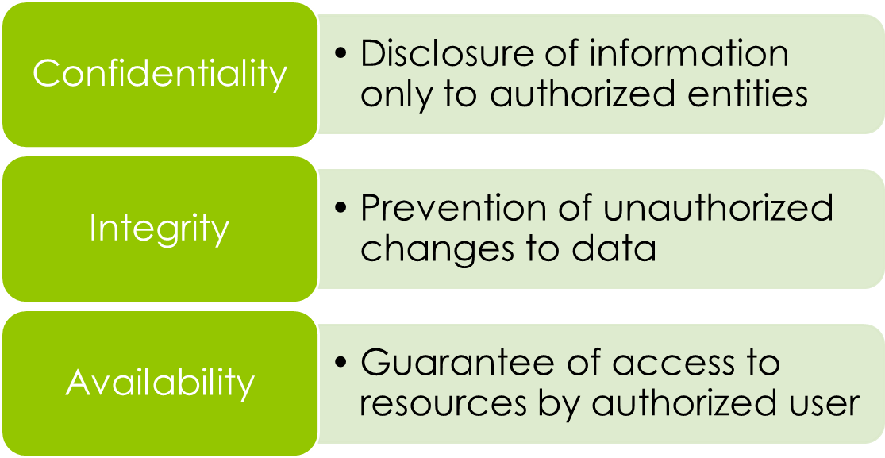
Element of Security

Slide 4
Attacks Classification
Active Attacks
  Modify the target system or message that violates the integrity of the system or message.
Passive Attacks
  Violates the confidentiality without affecting the state of the system.

Slide 5
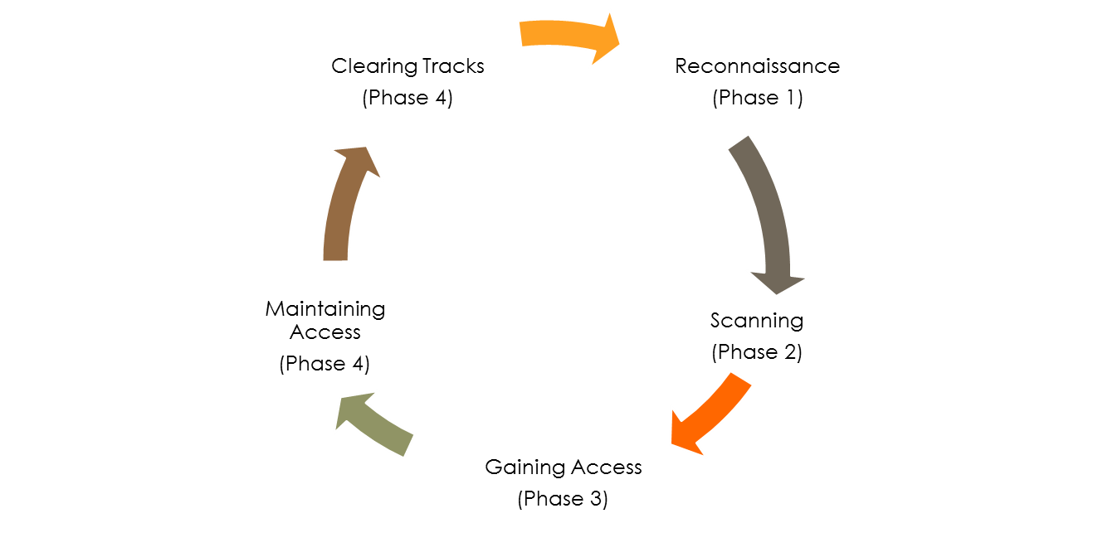
What Malicious Hacker Do

Slide 6
Phase 1: Reconnaisance
Preparatory (preliminary) phase where an attacker seeks to gather as much information as possible about a target of evaluation prior to launching an attack.
It involves network scanning either external or internal, without authorization.

Slide 7
Passive attack
  Gather the information without interacting with the system directly using public available information from the Internet, social engineering and dumpster diving
Active attack
  Interacts with the system by using tools to detect open ports, accessible hosts, router locations, network mapping, details of operating system and applications.

Slide 8
Footprinting
Footprinting is the process of accumulating data regarding a specific network environment, usually for the purpose of finding ways to intrude into the environment.
It results in a unique organizational profile with respect to networks.
An attacker spends 90% of the time in profiling an organization and another 10% in launching the attack (CEHv6, EC-Council)

Slide 9
Footprinting: Importance
Footprinting is necessary to systematically and methodically ensure that all pieces of information related to the target network are identified.

Slide 10
Footprinting: Tools
Such as:
  Whois
  Nslookup
  Neo Trace
  SmartWhois
  eMailTrackerPro
  Website watcher
  Google Earth
  E-mail Spider
  etc

Slide 11
Social Engineering: Introduction
is the art of convincing people to reveal confidential information
is the tactic or trick of gaining sensitive information by exploiting the basic human nature such as trust, etc

Slide 12
Social Engineering: Types
2 categories
  Human-based:
    Gathers sensitive information by interaction
    Attacks of this category exploit trust, fear, and helping nature of humans
  Computer-Based:
    Social engineering is carried out with the help of computers

Slide 13
Social Engineering:
Human-based - examples
Posing as legitimate end user
Posing as important user
Posing as technical support
Eavesdropping or unauthorized listening of conversations or reading of messages
Shoulder surfing
Dumpster diving
Tailgating
Piggybacking
etc

Slide 14
Social Engineering: Computer based - Examples
Mail / IM attachments
Pop-up Windows
Websites
Spam email
Instant Chat Messenger
Phishing
Etc.

Slide 15
Phase 2: Scanning
Pre-attack phase when the hacker scans the network for specific information on the basis of information gathered during reconnaisance.

Slide 16
Scanning:
Basic Countermeasures
The firewall of a particular network should be good enough to detect the probes of an attacker. The firewall should carry out inspection having a specific rule set
Network intrusion detection systems should be used to find out the OS detection method used by some tools such as Nmap.
Only necessary ports should be kept open and the rest should be filtered.
Do not reveal sensitive information that should not be disclosed to the public over the Internet.

Slide 17
Phase 3: Gaining Access
Hackers exploit the vulnerability in the system.
Factors influence the chances of an attacker gaining access into a target system include the architecture and configuration of the target system, the skill of the perpetrator (executor) and the initial level of access obtained.

Slide 18
Phase 4: Maintaining Access
After gaining access, attackers may choose to:
  use the system and resources as a launch pad or exploit other system
  Keep a low profile and continue exploiting the system
To maintain access, attackers will remove all evidence of their entry and use a backdoor or a Trojan to gain repeat access to the system.

Slide 19
Phase 5: Covering Tracks
Destroy evidence of his/her presence and activities for various reasons such as maintaining access and evading (escaping) punitive (disciplinary) action.
Reasons:
  To prolonged stay
  Continued use of resources
  Removing evidence of hacking
  Avoid legal action

